Slide 1
Tests & Measurement for People Who (Think They) Hate Tests & Measurement, Fourth Edition
Chapter 6: Item Response Theory: The “New” Kid on the Block

Slide 2
The Beginnings of Item Response Theory (1 of 3)
The importance of classical test theory.
A perspective on how test items should be developed and evaluated.
The other names of IRT.
The unique function of IRT: focus on test taker’s ability.
Notes:
6.1. Describe the brief history of item response theory and how it attempts to measure latent traits.
The Beginnings of Item Response Theory
The importance of classical test theory:
The study of the classical test theory started around 1920.
For so many years, the theory has been the basis for test development, administration, and evaluation.
It is still the prominent model used by researchers and even many large scale test developers.
Item response theory (IRT):
IRT or item response theory is a perspective on how test items should be developed and evaluated.
IRT obsesses over reliability more than validity and therefore the focus is on the individual test items and how well they discriminate among individuals and their various underlying levels of the trait being measured.
In other words, IRT uses information about the difficulty of each item and how it depends on the ability of each person taking the test.
The other names of IRT: latent trait theory, strong true score theory, and modern test theory.
The unique function of IRT:
IRT is an attractive alternative to classical test theory for the following reason.
The theory focuses on and estimates the ability of the test taker independent of the difficulty of the items.
It does this by looking at the relationship between the performance on each individual item on the test and the underlying (underlying because the level of ability is not explicit and is never a known quantity) ability of the test taker.

Slide 3
The Beginnings of Item Response Theory (2 of 3)
Calculating possible outcomes in IRT.
The development of IRT.
The complexity involved with IRT.
IRT needs technology.
Notes:
6.1. Describe the brief history of item response theory and how it attempts to measure latent traits.
The Beginnings of Item Response Theory
Calculating possible outcomes in IRT:
Consider an 11-item achievement test (like a super-short ACT test).
The test can have 11 different and possible scores ( 0 correct, 1 correct… up to 10 correct).
But in IRT, there are as many possible outcomes as there are possible item combinations.
The possible number of combos is the possible outcomes raised to the power of the number of items—in this example, 2¹⁰ or 1,024.
Therefore, rather than a mere 11 data points for performance, there are now 1,024 and this forms a finer scale (with better precision and decisions) to grade outcomes.
The development of IRT:
It was based mostly on the work of Robert Lord, Melvin Novak, and Alan Birnbaum in their seminal papers.
These papers were first published in the ’60s and ’70s and then brought to the attention of the tests and measurement world.
The complexity involved with IRT:
Though IRT is cool it has taken a long time for the approach to become popular.
It is because the use of IRT requires huge amounts of data for effective and accurate the analysis.
Thousands of individual test results are to be examined for the analysis to be trustworthy.
IRT needs technology:
Computers are necessary to handle the complexity of the calculations that are required to make IRT work.
Thousands and thousands of calculations are necessary to create the models that are necessary to test the quality of the outcomes and it is impractical to do it with computers.
Therefore, though IRT was invented five decades ago, the approach needed technology to catch up to grow.

Slide 4
The Beginnings of Item Response Theory (3 of 3)
Measuring the ability in IRT.
The less obvious trait.
IRT best measures the latent trait.
Notes:
6.1. Describe the brief history of item response theory and how it attempts to measure latent traits.
The Beginnings of Item Response Theory
Measuring the ability in IRT:
While discussing IRT, the term “ability” is used because it is developed for cognitive and achievement tests.
The term ability refers to “the construct.”
For instance, IRT can be used to build attitude scales and personality tests and the term ability is used to describe what is being measured.
When a person scores 100% or 50% correct on an achievement test, the score acts as an indirect measure of ability.
This score does not reflect the exact true ability of the individua but is certainly a starting point.
The less obvious trait:
The underlying construct is critical to IRT and is called latent trait.
Latent trait: a trait that is present but is not obvious.
The observed score of an individual is only an estimate and the true score remains a theoretical concept.
Therefore, the job of the modern psychometrician is to estimate as accurately as possible one’s true underlying latent trait score.
IRT best measures the latent trait:
The IRT can do a better job at estimating the latent trait than the classical test theory.
It considers each individual item and not just the total score.
It then looks at the patterns of responses across all items and all test takers to get an accurate estimate of individual ability.

Slide 5
This Is No Regular Curve: The Item Characteristic Curve (1 of 2)
Fundamental to understanding IRT.
Higher ability results in success.
Notes:
6.2. Interpret an item characteristic curve.
This Is No Regular Curve: The Item Characteristic Curve
Fundamental to understanding IRT:
The most fundamental aspect of understanding IRT is what is called the item characteristic curve (ICC).
Every item on a test has one item characteristic curve.
Higher ability results in success:
The IICC indicates the higher the ability for a person (higher the value of θ), the more likely it is for the person to see success on this one item.
At the highest levels of ability, the probability of getting a correct response should be very high.

Slide 6
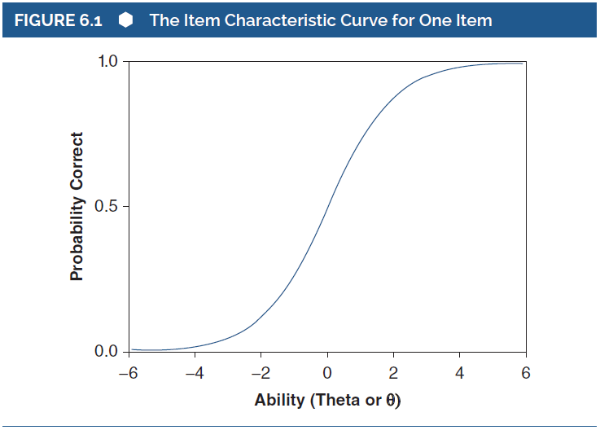
This Is No Regular Curve: The Item Characteristic Curve (2 of 2)
Notes:
6.2. Interpret an item characteristic curve.
Figure 6.1: The Item Characteristic Curve for One Item.
This Is No Regular Curve: The Item Characteristic Curve
In the above curve, the x- or horizontal axis represents the construct, the latent or underlying trait or ability that the individual test taker brings to the item itself.
This underlying ability is referred to as theta and represented as θ.
Average ability is located at 0 on the x-axis (that’s the mean ability level), above average ability to the right, and below-average ability to the left.
The y- or vertical axis is the probability of a correct response given a certain level of ability or θ.
The lower this value, the more difficult the particular item and vice versa.
Therefore, it can be stated that the probability of getting an item correct is the difficulty of the item.

Slide 7
Test Items We Like – and Test Items We Don’t (1 of 4)
Good items are reliable at different levels of ability.
The difficulty level of the item.
The discrimination level of the item.
Notes:
6.3. Define item difficulty and item discrimination within item response theory.
Test Items We Like – and Test Items We Don’t
Good items are reliable at different levels of ability:
Within IRT, every item has two characteristics to distinguish them from one another.
The two characteristics also allow to pass judgment on whether the item is a “good” one.
It is important to note that good items are reliable at different levels of ability.
The difficulty level of the item:
The first characteristic is the difficulty level of an item which is denoted by its location of the curve along the x-axis.
In IRT, items do not have one difficulty level, instead they have different difficulties for each ability level, a whole curve of difficulties.
The farther to the right the curve lies the more difficult the item and the farther to the left the easier the item.
The discrimination level of the item:
The second characteristic of the item is the discrimination level that is reflected in the steepness of the item characteristic curve.
So, the steeper the curve, the stronger the relationship between ability and the chance of getting a question right.
When the curve is steep, even a small change in ability leads to a change in the item difficulty and for a curve that is not that steep, a change in ability level doesn’t really affect difficulty that much.

Slide 8
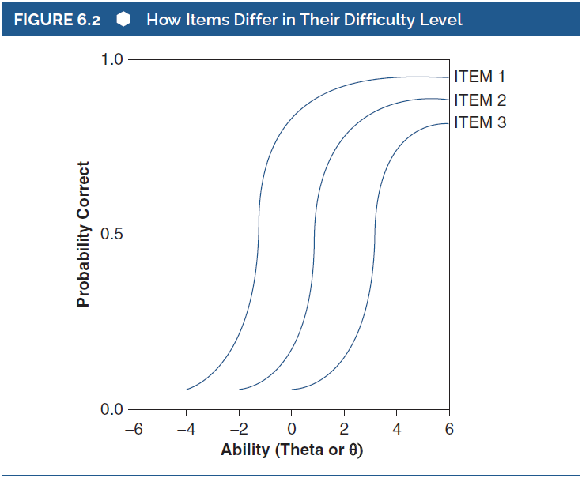
Test Items We Like – and Test Items We Don’t (2 of 4)
Notes:
6.3. Define item difficulty and item discrimination within item response theory.
Figure 6.2: How Items Differ in Their Difficulty Level.
Test Items We Like – and Test Items We Don’t
The figure shows that for all the items, the probability of getting the item correct increases as theta increases.
But, overall, Item 1 is easier than Item 2, and therefore it takes less ability to get Item 1 correct than it does to get Item 2 correct than it does to get Item 3 correct.
So, given the same level of ability (θ = .5, in this example), the probability of getting the item correct varies as a function of difficulty level.

Slide 9
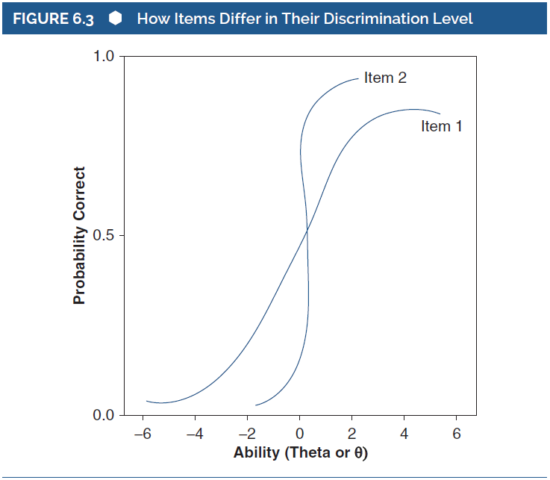
Test Items We Like – and Test Items We Don’t (3 of 4)
Notes:
6.3. Define item difficulty and item discrimination within item response theory.
Figure 6.3: How Items Differ in Their Discrimination Level.
Test Items We Like – and Test Items We Don’t
In the figure, the curve for Item 1 is steep and discriminates well and therefore for the same degree of ability, the probability of success can vary greatly.
But Item 2, does not discriminate well because the probability of a correct response is very similar regardless of underlying ability.

Slide 10
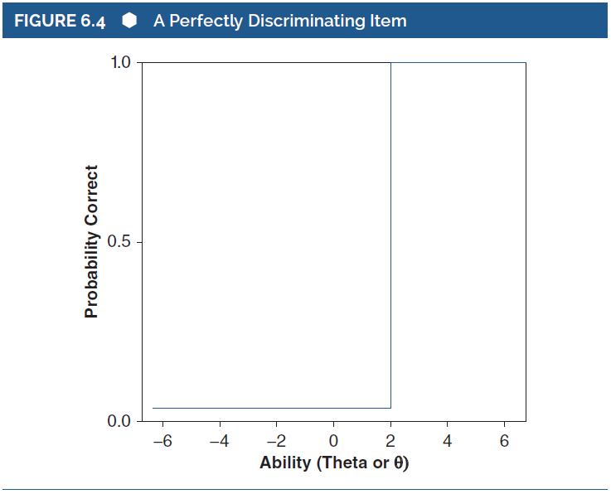
Test Items We Like – and Test Items We Don’t (4 of 4)
Notes:
6.3. Define item difficulty and item discrimination within item response theory.
Figure 6.4: A Perfectly Discriminating Item.
Test Items We Like – and Test Items We Don’t
Assume that the curve here is an item for a test where the purpose is to identify people at the 2.0 level of ability.
In this case, the item discriminates perfectly at that ability level.
In other words, all the individuals with a theta less than 2 (those below the cut-off) have a very low probability of getting the item correct, and individuals with a theta more than 2, have a 100% chance of getting the item correct.
This is how the perfect discrimination would look like.

Slide 11
Understanding the Curve (1 of 4)
Three different characteristics that help to understand an IRT curve.
  The discrimination level (a).
  The difficulty level (b).
  Chance of guessing the answer (c).
Notes:
6.4. Identify the difficulty, discrimination and guessing parameters using an item characteristic curve.
Understanding the Curve
Three different characteristics that help to understand an IRT curve:
The discrimination level (a):
The first characteristic is the discrimination level (slope of the curve), identified with an a.
The curve when steeper indicates a large difference in the probability of a correct response for those whose theta values differ and when flatter indicates a small difference.
The difficulty level (b):
The second characteristic is the difficulty level represented by b.
“b” is the theta value at which there is a 50% chance of getting the item correct.
When b has a higher value, it indicates that the item is more difficult than a lower value of b.
When value of b is less than 0, the lower ability level individuals have a good chance of getting the question correct and when b is greater than 0, it takes a higher ability level to get it right since these are harder items.
Chance of guessing the answer (c):
The third characteristic of the item is denoted as c.
It is the probability of a correct response for test takers who have no ability of getting the item correct.
For example, in a multiple-choice question with 4 answer options, one can just randomly guess and still have a 25% chance of getting the item right.
With a multiple-choice question, in real life, even a low ability test-taker has a decent chance of getting the question correct and thus c is considered to describe it.

Slide 12
Understanding the Curve (2 of 4)
Using PARAM to examine the IRC.
Evaluation and reevaluation of items.
Examples to understand the use of a and b.
Notes:
6.4. Identify the difficulty, discrimination and guessing parameters using an item characteristic curve.
Understanding the Curve
Using PARAM to examine the IRC:
Lawrence Rudner created a terrific applet called PARAM.
The applet can be used for varying the three parameters, a, b, and c, and seeing what the item characteristic curve looks like.
Evaluation and reevaluation of items:
To start at the basic level, it is better to focus on only the discrimination (a) and difficulty (b) values.
While using the two values to make decisions about the worthiness of an item, the items can be used, evaluated and refined.
Then, the items can be placed once again in the test pool of items, and reevaluated until they meet the criteria, used to define good items.
Examples to understand the use of a and b:
Consider an item is an easy item with a low level of difficulty equal to a theta of –2.5.
In this case, it discriminates fairly well between test takers with a fairly steep slope.
But when an item is a more “difficult” item with a difficulty level equal to 2.0, the curve is placed toward the right side of the x-axis and it doesn’t discriminate quite as well, with a slightly less pronounced slope.

Slide 13
Understanding the Curve (3 of 4)
Putting a, b, and c Together
Assessment of how well items are working.
Steps to create a test while using IRT.
Deciding when the process is complete.
Information function: summarizes the usefulness of an item.
Notes:
6.4. Identify the difficulty, discrimination and guessing parameters using an item characteristic curve.
Putting a, b, and c Together
Assessment of how well items are working: The values of a and b (and c, the guessing parameter) are mostly used in the assessment of how well items are working and which need to be revised.
Steps to create a test while using IRT:
The steps for the creation of a test consisting of many items and using IRT as a tool would be as follows:
Items are created by the test developer.
Items are included on a test.
The test is administered to a very large representative sample.
IRT is used to evaluate the usefulness of each item, one by one, and how well it “works.”
If necessary (which it almost always is), the test item is refined, rewritten, redrafted, etc., until there is another opportunity to use the item once again and revise as necessary according to the new values of a, b, and c.
Deciding when the process is complete:
The process of item and test development is complete when each item fits the difficulty and discrimination level that the test author feels adequate.
But this is a subjective decision because the reliability and validity of an item depends on the ability level of the individual test-taker.
So, an item might work well for high ability people, but not as well for low ability people.
Information function:
Another ICC function assesses the amount of information revealed through an IRT analysis – information function.
This function essentially summarizes the usefulness of an item, or a test made up of a bunch of specific items.
The information function is an example of how IRT has powers that classical test development methods do not.
IRT allows the estimation of reliability of a group of items used together without collecting data on that particular test or mix of items.

Slide 14
Understanding the Curve (4 of 4)
Putting a, b, and c Together
IRT and Computerized Adaptive Testing.
Customized tests based on abilities.
Notes:
6.4. Identify the difficulty, discrimination and guessing parameters using an item characteristic curve.
Putting a, b, and c Together
IRT and Computerized Adaptive Testing:
When the difficulty and discrimination levels of a bunch of items are known, the test administrator can make use of an individual’s performance thus far and adjust what subsequent items he or she will have to answer.
So, for instance, if Larry gets an item wrong and it is too difficult, the computer program can adjust which item is to be presented next, something that is perhaps easier.
Customized tests based on abilities:
Since the computer program will adjust the presentation of items based on difficulty and discrimination levels and maximize assessment, everyone gets a customized test.
The computer testing software keeps a constant estimate of a test-taker’s ability level (their theta) and gives them items that work best for that ability level.
That estimate can change during the test administration, and the software picks different items based on that changing estimate.

Slide 15
Analyzing Test Data Using IRTPRO (1 of 6)
Powerful and affordable technology makes IRT more accessible.
The use of IRTPRO.
Notes:
6.5. List a few software options for item response theory analyses and what information they produce.
Analyzing Test Data Using IRTPRO
Powerful and affordable technology makes IRT more accessible:
Computers were and are critical to the use of IRT.
As computers have become smaller, more powerful, and more affordable, the software to conduct sophisticated analyses has become more accessible too and IRT is no exception.
The use of IRTPRO:
There are many different programs available to conduct IRT analyses and IRTPRO from Vector Psychometric Group is one such.
Schools may provide access to IRTPRO and there are some free options to play around with to get a sense of item response theory analyses.
One can get free demo versions of these programs:
WINSTEPS at https://www.winsteps.com/index.htm
Facets, also at https://www.winsteps.com/index.htm
BILOG, there isn’t a free demo version, but there are downloadable examples of data and analyses at https://ssicentral.com/index.php/products/bilogmg-gen/
flexMIRT at https://vpgcentral.com/software/flexmirt/

Slide 16
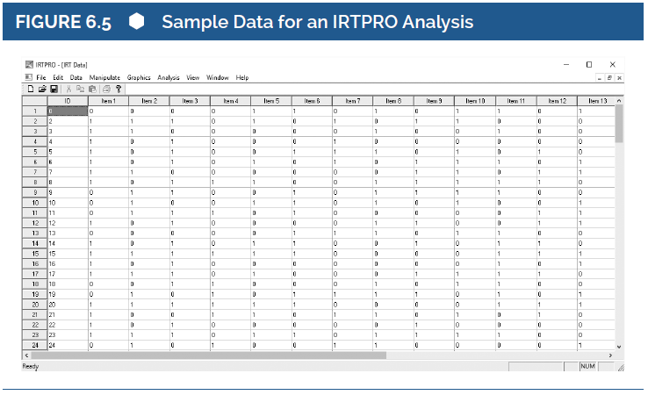
Analyzing Test Data Using
IRTPRO (2 of 6)
Notes:
6.5. List a few software options for item response theory analyses and what information they produce.
Figure 6.5: Sample Data for an IRTPRO Analysis.
Analyzing Test Data Using IRTPRO
The sample used for analysis is the result of a 20-item test taken by 500 individuals.
The result of a 20-item test taken by 500 individuals.
This figure shows a sample of the item scores where columns are items, rows are individuals, and cell entries are correct (1) or incorrect (0) for any one item.
For example, for Individual Test Taker 12, Item 3 was correct (there is a value of 1 entered in that cell).

Slide 17
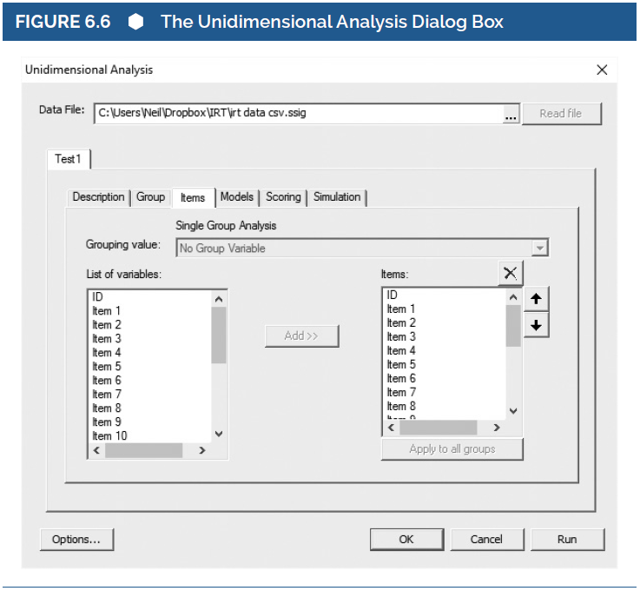
Analyzing Test Data Using
IRTPRO (3 of 6)
Notes:
6.5. List a few software options for item response theory analyses and what information they produce.
Figure 6.6: The Unidimensional Analysis Dialog Box.
Analyzing Test Data Using IRTPRO
The above figure shows the Unidimensional Analysis dialog box, where the items were added to the analysis.
When the RUN button is clicked, the results of the analysis will be shown.

Slide 18
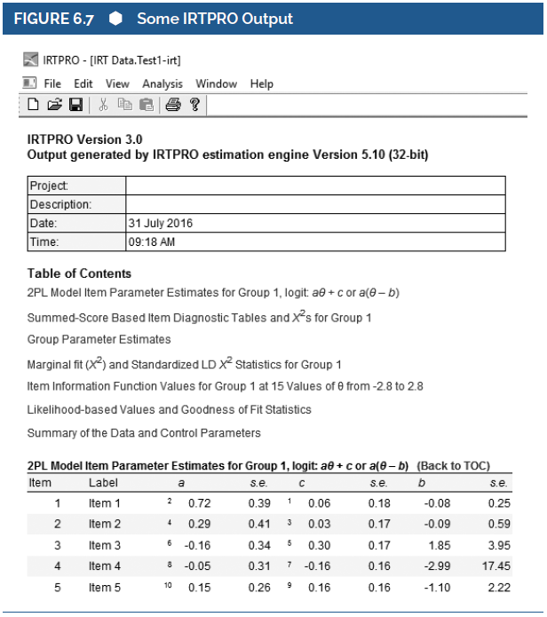
Analyzing Test Data Using IRTPRO (4 of 6)
Notes:
6.5. List a few software options for item response theory analyses and what information they produce.
Figure 6.7: Some IRTPRO Output.
Analyzing Test Data Using IRTPRO
This figure shows the result of the analysis that appears when the RUN button is clicked.
Sophisticated software programs such as IRTPRO produce a large amount of output.
This figure gives lots of information about which items may be kept, and which really need to be revised.
For instance, Item 1 is shown to discriminate well (a = .72) and is of about average difficulty (b = –.08) and Item 4 does not discriminate well (a = –.05) and is very easy (b = –2.99).
Based on this, the test developer will decide which items can be kept in the item bank and, of those, which should be revised before they are used again.

Slide 19
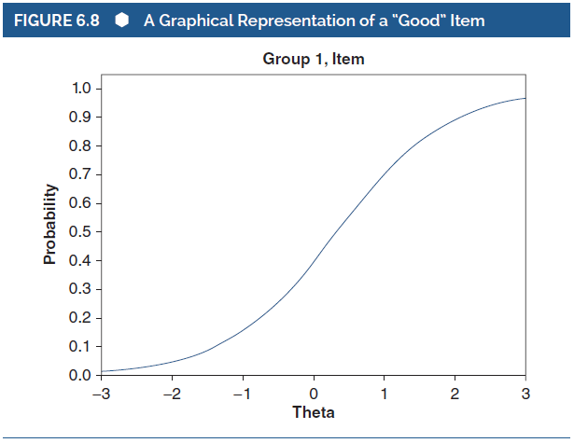
Analyzing Test Data Using
IRTPRO (5 of 6)
Seeing is Believing
Notes:
6.5. List a few software options for item response theory analyses and what information they produce.
Figure 6.8: A Graphical Representation of a “Good” Item.
Seeing is Believing
In addition to knowing the values of a, b, and c, it is better to be able to see them as a representation of how “good” an item is.
This figure shows the actual IRTPRO output for an item characteristic item (ICC) of what is a relatively decent item.

Slide 20
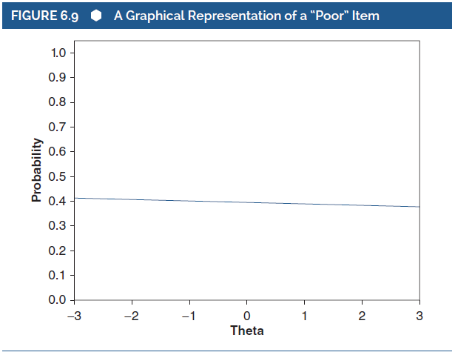
Analyzing Test Data Using
IRTPRO (6 of 6)
Notes:
6.5. List a few software options for item response theory analyses and what information they produce.
Figure 6.9: A Graphical Representation of a “Poor” Item.
Seeing is Believing
This figure shows the graphical representation of an unattractive item, one that has little discrimination power and difficulty that does not change as a function of ability.

